Slide 1
The Observer Template for List Data
CS 5010 Program Design Paradigms “Bootcamp”
Lesson 4.2
© Mitchell Wand, 2012-2017
This work is licensed under a Creative Commons Attribution-NonCommercial 4.0 International License.
TexPoint fonts used in EMF.
Read the TexPoint manual before you delete this box.: AAA

Slide 2
Key Points for Lesson 4.2
At the end of this lesson you should be able to:
Write down the observer template for list data.
Use the observer template for list data to write simple functions on lists.

Slide 3
Review: The Constructor Templates for XList
A XList is one of
-- empty
-- (cons X XList)
Here are the constructor templates for a list of X's. This means that any XList must look like one of these two forms

Slide 4
This definition is self-referential
A XList is one of
-- empty
-- (cons X XList)
Here are the constructor templates for a list of X's. This means that any XList must look like one of these two forms

Slide 5
Observer Template (1st attempt)
;; xlist-fn: XList -> ??
(define (xlist-fn xs)
(cond
[(empty? xs) ...]
[else (... (first xs)
(rest xs))]))

Slide 6
But we should do something cleverer!
The constructor template was self-referential
But this wasn't reflected in our observer template.
(rest xs) is an XList, so we should expect to call xlist-fn recursively on it.
This is usually (though not always) what you want.

Slide 7
The Observer Template for List data
;; xlist-fn : XList -> ??
(define (xlist-fn xs)
(cond
[(empty? xs) ...]
[else (... (first xs)
(xlist-fn (rest xs)))]))
Here we add a recursive call to list-fn on (rest xs) .
Observe that xs is non-empty when first and rest are called, so their contracts are satisfied.

Slide 8
This template is self-referential
;; list-fn : XList -> ??
(define (xlist-fn xs)
(cond
[(empty? xs) ...]
[else (... (first xs)
(xlist-fn (rest xs)))]))
(rest xs) is a XList, so call xlist-fn on it
New Slogan: Self-reference in the constructor template leads to self-reference in the observer template.

Slide 9
Remember: The Shape of the Program Follows the Shape of the Data
Xlist
xlist-fn
has-as-component
calls
Xlist
xlist-fn
Data Hierarchy (a non-empty Xlist contains another Xlist)
Call Tree (xlist-fn calls itself on the component)
or, folding in the recursion....:

Slide 10
Remember: The Shape of the Program Follows the Shape of the Data
Xlist
xlist-fn
is-component-of
calls
Data Hierarchy (a non-empty Xlist contains another Xlist)
Call Tree (xlist-fn calls itself on the component)

Slide 11
From Observer Template to Function Definition
The observer template has two blanks in it.
Often we can get our function definition by simply filling in the blanks.
Each blank corresponds to a question
It's the same question for every function:

Slide 12
Let’s do some examples
We’ll be working with the list template a lot, so let’s do some examples to illustrate how it goes.
We’ll do 5 examples, starting with one that’s very simple and working up to more complicated ones.

Slide 13
Here are the questions for the XList template:
;; xlist-fn : XList -> ??
(define (xlist-fn xs)
(cond
[(empty? xs) ...]
[else (... (first xs)
(xlist-fn (rest xs)))]))
What's the answer for the empty list?
If we knew the first of the list, and the answer for the rest of the list, how could we combine them to get the answer for the whole list?

Slide 14
Data Definitions
;; A NumberList is represented as a list of Number.
;; CONSTRUCTOR TEMPLATE AND INTERPRETATION
;; empty -- the empty sequence
;; (cons n ns)
;; WHERE:
;; n is a Number -- the first number
;; in the sequence
;; ns is a NumberList -- the rest of the
;; numbers in the sequence
;; OBSERVER TEMPLATE:
;; nl-fn : NumberList -> ??
(define (nl-fn lst)
(cond
[(empty? lst) ...]
[else (... (first lst)
(nl-fn (rest lst)))]))

Slide 15
Example 1: nl-length
nl-length : NumberList -> Number
GIVEN: a NumberList
RETURNS: its length
EXAMPLES:
(nl-length empty) = 0
(nl-length (cons 11 empty)) = 1
(nl-length (cons 33 (cons 11 empty))) = 2
STRATEGY: Use template for NumberList on lst
We write "nl-" as an abbreviation for NumberList

Slide 16
Example 1: nl-length
;; nl-length : NumberList -> Number
;; Given a NumberList, find its length
(define (nl-length lst)
(cond
[(empty? lst) ...]
[else (... (first lst)
(nl-length (rest lst)))]))
We start by copying the template and changing the name of the function to nl-length.

Slide 17
Example 1: nl-length
;; nl-length : NumberList -> Number
;; Given a NumberList, find its length
(define (nl-length lst)
(cond
[(empty? lst) 0]
[else (+ 1 (first lst)
(nl-length (rest lst)))]))
;; nl-length : NumberList -> Number
;; Given a NumberList, find its length
(define (nl-length lst)
(cond
[(empty? lst) ...]
[else (... (first lst)
(nl-length (rest lst)))]))
What's the answer for the empty list?
Next, we answer the template questions.
If we knew the first of the list, and the answer for the rest of the list, how could we combine them to get the answer for the whole list?

Slide 18
The code is self-referential, too
;; nl-length : NumberList -> Number
;; Given a NumberList, find its length
(define (nl-length lst)
(cond
[(empty? lst) 0]
[else (+ 1 (first lst)
(nl-length (rest lst)))]))
Self-reference in the constructor template leads to self-reference in the observer template;
Self-reference in the observer template leads to self-reference in the code.

Slide 19
Let's watch this work
(nl-length (cons 11 (cons 22 (cons 33 empty))))
= (+ 1 (nl-length (cons 22 (cons 33 empty))))
= (+ 1 (+ 1 (nl-length (cons 33 empty))))
= (+ 1 (+ 1 (+ 1 (nl-length empty))))
= (+ 1 (+ 1 (+ 1 0)))
= (+ 1 (+ 1 1))
= (+ 1 2)
= 3
See how each recursive call to nl-length works on a shorter and shorter list.

Slide 20
Example 2: nl-sum
nl-sum : NumberList -> Number
GIVEN: a list of numbers
RETURNS: the sum of the numbers in the list
EXAMPLES:
(nl-sum empty) = 0
(nl-sum (cons 11 empty)) = 11
(nl-sum (cons 33 (cons 11 empty))) = 44
(nl-sum (cons 10 (cons 20 (cons 3 empty)))) = 33
STRATEGY: Use template for NumberList on lst
Here's another example

Slide 21
Example 2: nl-sum
What's the answer for the empty list?
;; nl-sum : NumberList -> Number
(define (nl-sum lst)
(cond
[(empty? lst) ...]
[else (... (first lst)
(nl-sum (rest lst)))]))
;; nl-sum : NumberList -> Number
(define (nl-sum lst)
(cond
[(empty? lst) 0]
[else (+ (first lst)
(nl-sum (rest lst)))]))
If we knew the first of the list, and the answer for the rest of the list, how could we combine them to get the answer for the whole list?

Slide 22
Watch this work:
(nl-sum (cons 11 (cons 22 (cons 33 empty))))
= (+ 11 (nl-sum (cons 22 (cons 33 empty))))
= (+ 11 (+ 22 (nl-sum (cons 33 empty))))
= (+ 11 (+ 22 (+ 33 (nl-sum empty))))
= (+ 11 (+ 22 (+ 33 0)))
= (+ 11 (+ 22 33))
= (+ 11 55)
= 66

Slide 23
Example 3: double-all
double-all : NumberList -> NumberList
GIVEN: a NumberList,
RETURNS: a sequence just like the original, but
with each number doubled
EXAMPLES:
(double-all empty) = empty
(double-all (cons 12 empty))
= (cons 24 empty)
(double-all (cons 33 (cons 12 empty)))
= (cons 66 (cons 24 empty))
STRATEGY: Use template for NumberList on lst

Slide 24
Example 3: double-all
;; double-all : NumberList -> NumberList
(define (double-all lst)
(cond
[(empty? lst) ...]
[else (... (first lst)
(double-all (rest lst)))]))
;; double-all : NumberList -> NumberList
(define (double-all lst)
(cond
[(empty? lst) empty ]
[else (cons (* 2 (first lst))
(double-all (rest lst)))]))
What's the answer for the empty list?
If we knew the first of the list, and the answer for the rest of the list, how could we combine them to get the answer for the whole list?

Slide 25
Watch this work:
(double-all (cons 12 (cons 22 (cons 33 empty))))
= (cons 24 (double-all (cons 22 (cons 33 empty))))
= (cons 24 (cons 44 (double-all (cons 33 empty))))
= (cons 24 (cons 44 (cons 66 (double-all empty))))
= (cons 24 (cons 44 (cons 66 empty)))

Slide 26
Example 4: remove-evens
For this one, we'll need to specialize to integers.
An IntList is one of
-- empty
-- (cons Integer IntList)

Slide 27
Example 4: remove-evens
remove-evens is not a perfect name for this function, since it’s a verb rather than a noun.
remove-evens : IntList -> IntList
GIVEN: a IntList,
RETURNS: a list just like the original, but with all
the even numbers removed
EXAMPLES:
(remove-evens empty) = empty
(remove-evens (cons 12 empty)) = empty
(define list-22-11-13-46-7
(cons 22 (cons 11 (cons 13 (cons 46 (cons 7 empty))))))
(remove-evens list-22-11-13-46-7)
= (cons 11 (cons 13 (cons 7 empty)))
STRATEGY: Use observer template for IntList

Slide 28
Example 4: remove-evens
What's the answer for the empty list?
remove-evens : IntList -> IntList
(define (remove-evens lst)
(cond
[(empty? lst) empty]
[else (if (even? (first lst))
(remove-evens (rest lst))
(cons (first lst)
(remove-evens (rest lst))))]))
remove-evens : IntList -> IntList
(define (remove-evens lst)
(cond
[(empty? lst) ...]
[else (... (first lst)
(remove-evens (rest lst)))]))
If we knew the first of the list, and the answer for the rest of the list, how could we combine them to get the answer for the whole list?

Slide 29
Example 4: remove-evens
remove-evens : IntList -> IntList
(define (remove-evens lst)
(cond
[(empty? lst) empty]
[else (if (even? (first lst))
(remove-evens (rest lst))
(cons (first lst)
(remove-evens (rest lst))))]))
This code seems a little complicated. Could we make it more readable?

Slide 30
Example 4: remove-evens
remove-evens : IntList -> IntList
(define (remove-evens lst)
(cond
[(empty? lst) empty]
[(even? (first lst))
(remove-evens (rest lst))]
[else (cons (first lst)
(remove-evens (rest lst)))]))
Here’s a clearer version, which is also acceptable for this class. The template is just a way for you to get started writing your function definition. It's OK to vary it a little if it leads to more readable code.

Slide 31
Example 5: remove-first-even
remove-first-even : IntList -> IntList
GIVEN: a IntList,
RETURNS: a list just like the original, but with all the
even numbers removed
EXAMPLES:
(remove-first-even empty) = empty
(remove-first-even (cons 12 empty)) = empty
(define list-22-11-13-46-7
(cons 22 (cons 11 (cons 13 (cons 46 (cons 7 empty))))))
(remove-first-even list-22-11-13-46-7)
= (cons 11 (cons 13 (cons (cons 46 (cons 7 empty))))))
STRATEGY: Use template for IntList on lst
Why is this not a good set of examples?
Answer: None of them show what happens when the first element of the list is odd

Slide 32
Example 5: remove-first-even
What's the answer for the empty list?
remove-first-even : IntList -> IntList
(define (remove-first-even lst)
(cond
[(empty? lst) empty]
[else (if (even? (first lst))
(rest lst)
(cons (first lst)
(remove-first-even (rest lst))))]))
remove-first-even : IntList -> IntList
(define (remove-first-even lst)
(cond
[(empty? lst) ...]
[else (... (first lst)
(remove-first-even (rest lst)))]))
remove-first-even : IntList -> IntList
(define (remove-first-even lst)
(cond
[(empty? lst) empty]
[else (... (first lst)
(remove-first-even (rest lst)))]))
This is OK: you don’t have to recur if you don’t need to.
If we knew the first of the list, and the answer for the rest of the list, how could we combine them to get the answer for the whole list?

Slide 33
Example 5: remove-first-even
remove-first-even : IntList -> IntList
(define (remove-first-even lst)
(cond
[(empty? lst) empty]
[(even? (first lst))
(rest lst)]
[(cons (first lst)
(remove-first-even (rest lst)))]))
Again, here's another version of remove-first-even that is acceptable. It's OK to vary the template, but you'll be less likely to make mistakes if you stick close to the template.

Slide 34
Example 6: insert
;; DATA DEFINITION
;; A SortedIntList is an IntList that is in ascending
;; order.
This assumes that we already have a definition for IntList.

Slide 35
Example 6: insert
;; insert : Integer SortedIntList -> SortedIntList
;; GIVEN: An integer and a sorted sequence of integers
;; RETURNS: A new SortedIntList just like the
;; original, but with the new integer inserted.
;; EXAMPLES:
;; (insert 3 empty) = (list 3)
;; (insert 3 (list 5 6)) = (list 3 5 6)
;; (insert 3 (list -1 1 5 6))
;; = (list -1 1 3 5 6)
;; STRATEGY: Use observer template for
;; SortedIntList

Slide 36
Function Definition for insert
(define (insert n seq)
(cond
[(empty? seq) (cons n empty)]
[(< n (first seq)) (cons n seq)]
[else (cons (first seq)
(insert n (rest seq)))]))

Slide 37
Watch this work:
(insert 27 (cons 11 (cons 22 (cons 33 empty))))
= (cons 11 (insert 27 (cons 22 (cons 33 empty))))
= (cons 11 (cons 22 (insert 27 (cons 33 empty))))
= (cons 11 (cons 22 (cons 27 (cons 33 empty))))
Observe that this computation may take time proportional to the length of the sequence (in this case, 3).

Slide 38
Example 7: Insertion Sort
;; mysort : IntList -> SortedIntList
;; GIVEN: An integer sequence
;; RETURNS: The same sequence,
;; but sorted by <= .
;; EXAMPLES:
;; (mysort empty) = empty
;; (mysort (list 3)) = (list 3)
;; (mysort (list 2 1 4)) = (list 1 2 4)
;; (mysort (list 2 1 4 2)) = (list 1 2 2 4)
;; STRATEGY: Use observer template for
;; IntList
sort is predefined in ISL, so we need to use a different name.

Slide 39
Function definition for mysort
(define (mysort ints)
(cond
[(empty? ints) empty]
[else (insert (first ints)
(mysort (rest ints)))]))
The second argument to insert is always supposed to be a SortedIntList. Why is this true? (Hint: look at the contract for mysort.)

Slide 40
Watch this work:
(mysort (list 2 1 4 2))
= (insert 2 (mysort (list 1 4 2)))
= (insert 2 (insert 1 (mysort (list 4 2))))
= (insert 2 (insert 1 (insert 4 (mysort (list 2)))))
= (insert 2 (insert 1 (insert 4 (insert 2 (mysort empty)))))
= (insert 2 (insert 1 (insert 4 (insert 2 empty))))
= (insert 2 (insert 1 (insert 4 (list 2))))
= (insert 2 (insert 1 (list 2 4)))
= (insert 2 (list 1 2 4)))
= (list 1 2 2 4))

Slide 41
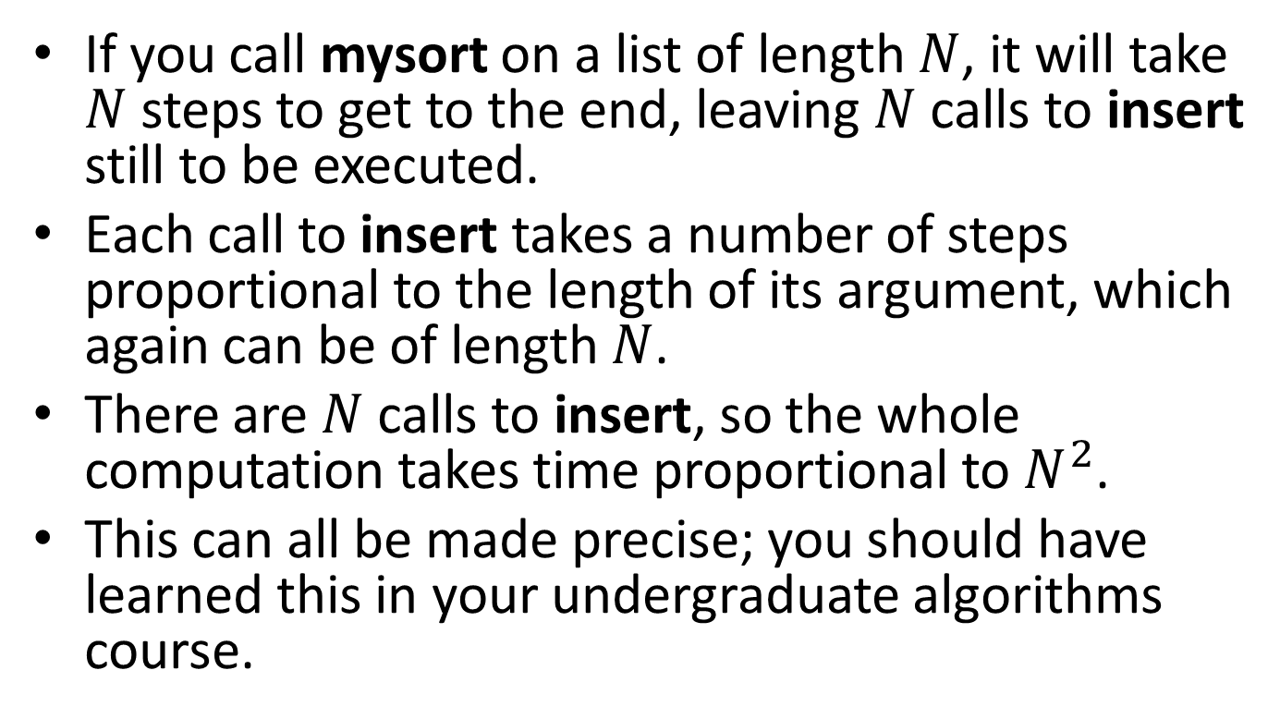
How many steps does this take?
If you call mysort on a list of length $N$, it will take $N$ steps to get to the end, leaving $N$ calls to insert still to be executed.
Each call to insert takes a number of steps proportional to the length of its argument, which again can be of length $N$.
There are $N$calls to insert, so the whole computation takes time proportional to $N^{2}$.
This can all be made precise; you should have learned this in your undergraduate algorithms course.

Slide 42
Summary
You should now be able to:
write down the template for a list data definition
use structural decomposition to define simple functions on lists

Slide 43
Next Steps
Study 04-1-lists.rkt in the Examples folder.
If you have questions about this lesson, ask them on the Discussion Board
Go on to the next lesson

